Slide 1

Al-Hujjat Study Centre Presentation for Parents
August 16th, 2020

Slide 2
Opening Quran Recitation by Maulana Syed Saghir

Slide 3
Today on Our Agenda:
Madrasa Operations for the 2020-2021 year
Introductions of Admin Team and Teachers
Registrations and Website
Online Learning Expectations
Google Classroom
Tarbiyah and Quran Syllabus Overview

Slide 4


Study Centre Format in September
Classes will begin on Sunday, September 13
There will be a Tarbiyah (Diniyat) and Quran Class for every student
Timings:
Tarbiyah Classes → 10:30-12:00 - 45 minutes per class
Quran → 12:00-1:00
ALL CLASSES WILL BE ONLINE ON ZOOM using GOOGLE CLASSROOM

Slide 5
AL-HUJJAT ADMIN TEAM
Principal: Mubina Panju
Vice Principal: Areej Raza
Secretary: Bashira Valji
Treasurer: Syed Aamir Rizvi
Director of Operations: Annamaria Namazie
Director of Student Services: Frouz Paiwand
Religious Advisor: Maulana Syed Saghir

Slide 6
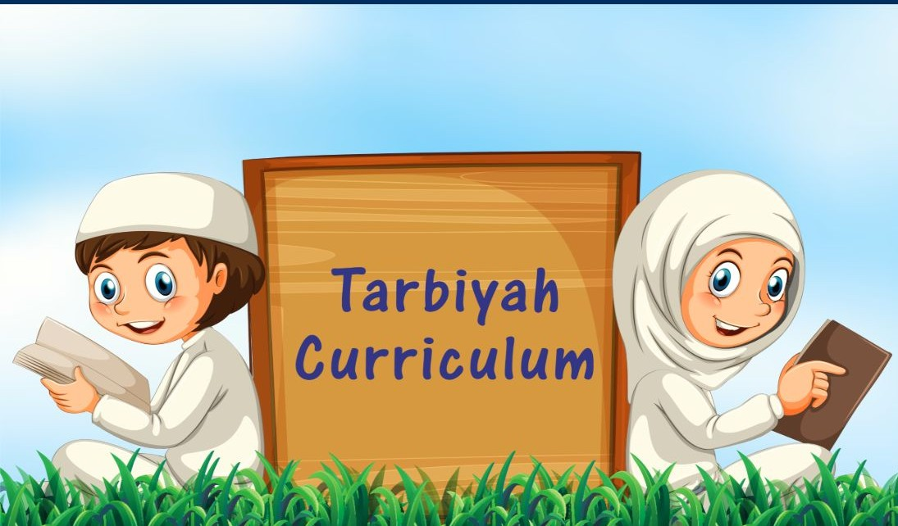
TARBIYAH/DINIYAT TEACHERS
Head Assistants: Anar Gulamhussein and Laila Haider
Band A (5-6 years) - Saniya Jamani
Band B (7-8 years) - Fareeha Syeda
Band C (9-10 years) - Afaneen Aljanabi
Band D (11-12 years) - Nagham Al-Fartoussi
Band E (13-14 years) - Maulana Syed Saghir + Quraish Hussain
Band F (15-16 years) - Annamaria Namazie

Slide 7
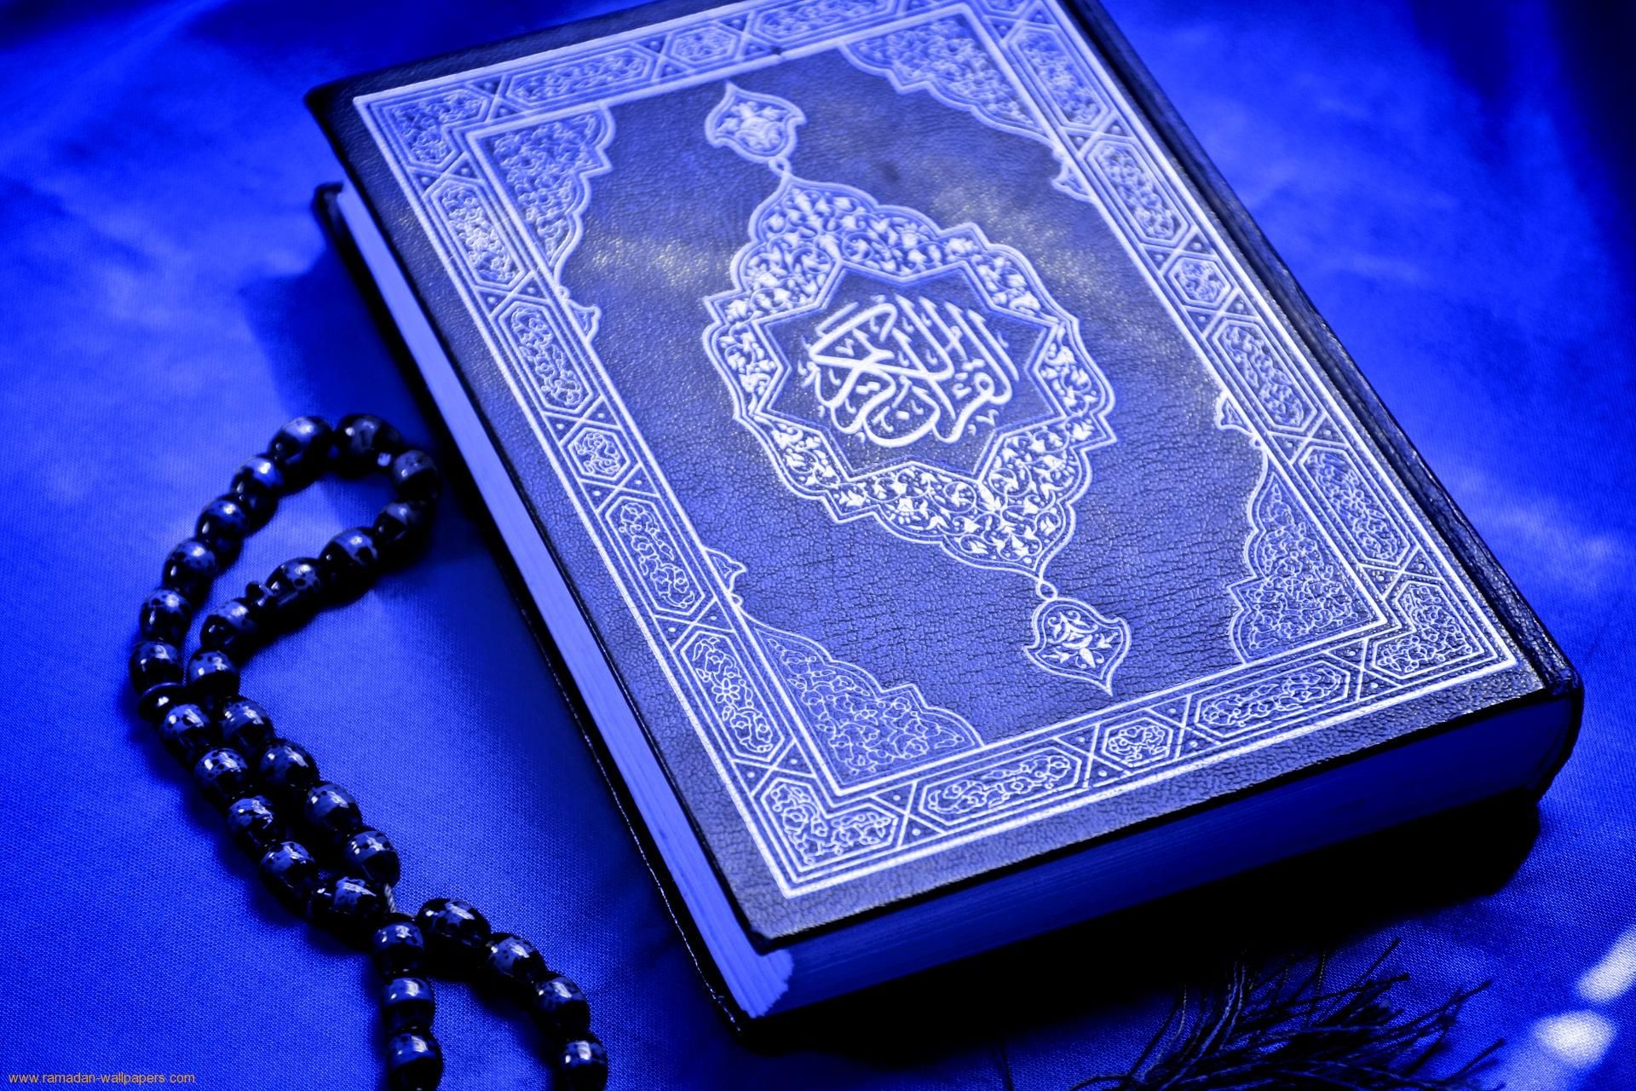
QURAN TEACHERS
Level 1: Nesreen Mezal
Level 2: Nagham Al-Fartoussi Level 3: Afaneen Aljanabi Level 4: Quraish Hussain Level 5: Zeineb Muhsen Level 6: Sarah Ali

Slide 8
Registrations
Please email us the names and birth dates of students so we can place them in classes
You will be sent registration forms to ﬁll out by email and these are due by September 5th.
Payment for TERM 1 is $ 50 per student:
Option 1: E-Transfer amount to: ﬁnance@jaffari.org (provide details within transfer - Al-Hujjat Study Centre and Student Names)
Option 2: Call ISIJ and pay over phone: 905-695-9786 (provide
details over phone - Al-Hujjat Study Centre and Student Names)
Email: principal@al-hujjat.ca or treasurer@al-hujjat.ca for questions about subsidies payment issues

Slide 9
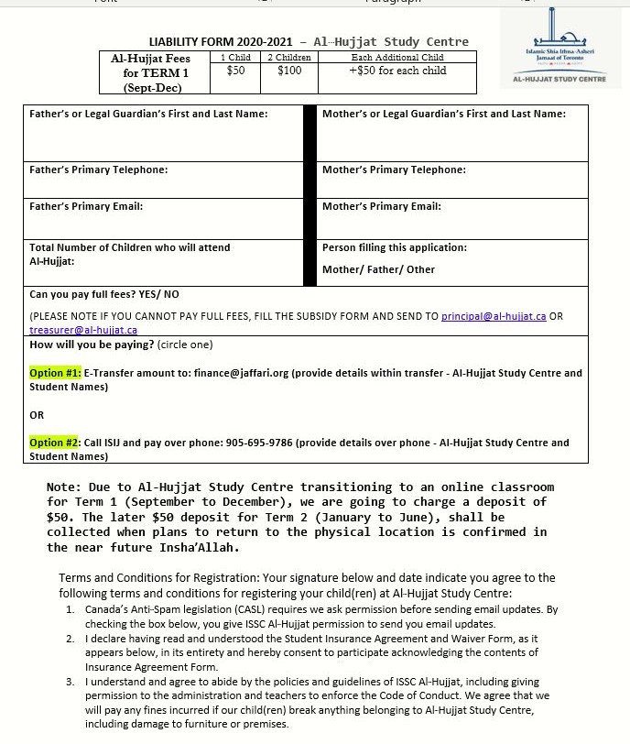
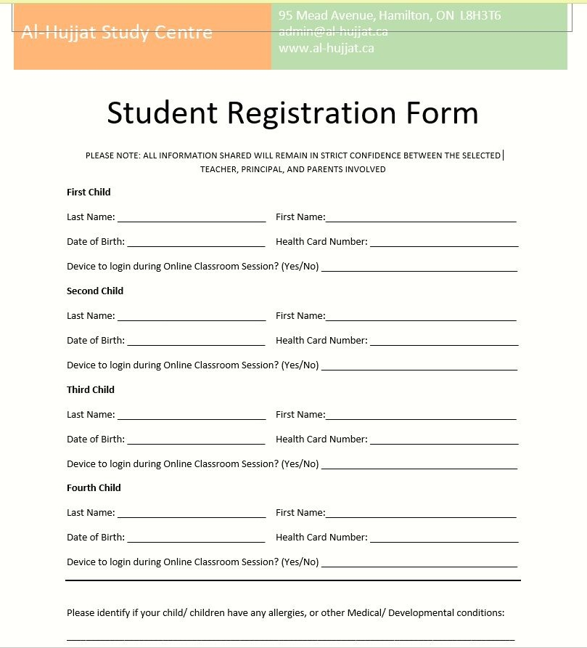

Slide 10
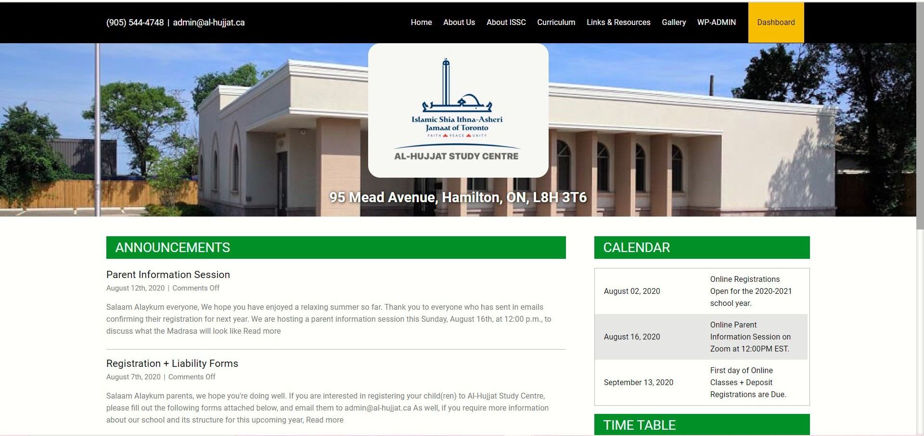
Al Hujjat Website
We have a new website where we will share information and resources
This PPT, the calendar will be on the website
https://al-hujjat.ca/

Slide 11
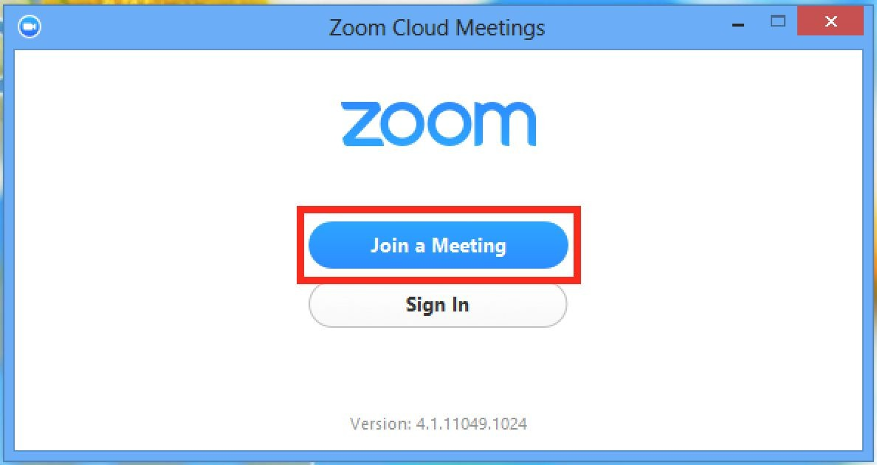
Accessing Online Classrooms
You will be sent a link for your Zoom classes. There will be a Zoom link for the Tarbiya Class and a separate Zoom link for the Quran class
Please ensure you have a device per child so they can log on.
Students will be given instructions to join an online Google Classroom.
This is where all the class material and assessment will be stored.

Slide 12
Guidelines for Al-Hujjat’s Google Classroom
For the younger kids, (Bands A-B), parents will be responsible for keeping track of teacher posts on the student’s Google Classroom.
Review posts each week using link in e-mail or accessing the online classroom OR by downloading free google classroom App on your phone and getting notiﬁcations every time something is posted.
Be positive, polite, and courteous
Participate in class discussions as directed by teachers, via chat or voice
Students to complete and submit assignments by due date
Ask questions if you are not sure or don’t understand

Slide 13
Online Class Guidelines
Parents with younger students should sit with them during the class.
Check posts in classroom and plan to attend online class as attendance will be taken
Join meeting room on time and mute microphone to avoid background noise
Islamic dress code is mandatory/maintain hijab
Participate in discussions using audio and/or answer questions using Chat option
Wait until person speaking has ﬁnished
Do not post any negative or rude comments
Do not record any portion of the online class
Do not sharing contents of the online meeting

Slide 14

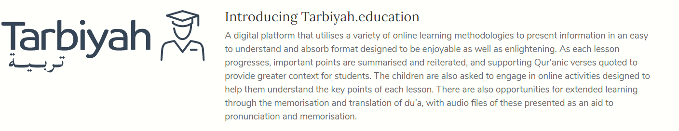
INTRODUCTION to Tarbiyah
MCE: Madrasah Center of Excellence
Tarbiyah: the key vision is to Nurture Piety
Notes:
Areej

Slide 15




Based on Qur’anic worldview of Birr (piety)
Key
Integrated approach
distinguishing features of the MCE Curriculum Framework
MCE CURRICULUM FRAMEWORK
Consistent application of framework through all the
age bands
Learner centred approach
13

Slide 16
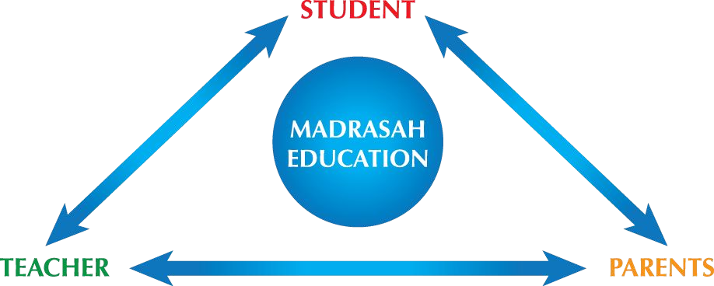
GUIDING PRINCIPLES OF THE MCE CURRICULUM FRAMEWORK
14

Slide 17
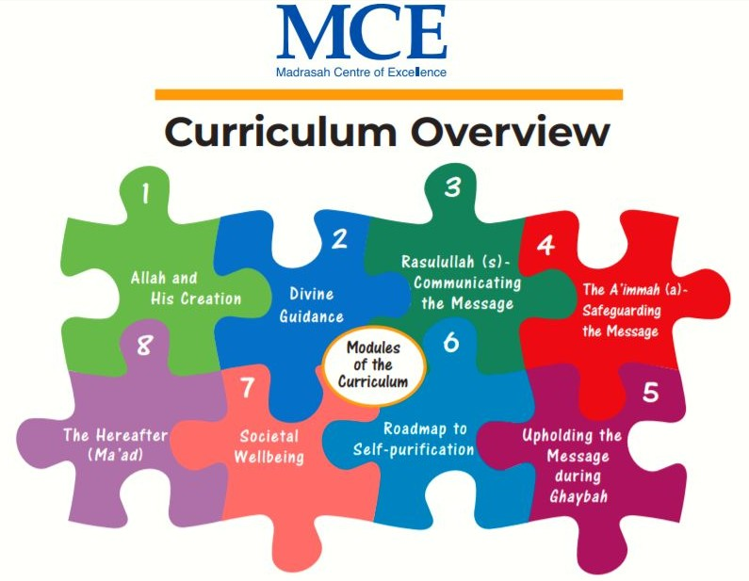
Al-Hujjat Tarbiyah Plan
Tarbiyah is the new curriculum we are implementing for Diniyat to replace old Sirat Curriculum
2 Year Band Program - Each Band takes 2 Years for Completion
  Year 1 - Covers ﬁrst half of the content per Band
  Year 2 - Covers second half of the content per Band
    Therefore, students will spend 2 years per band (6 Bands in Total)
There are 8 Modules/ Band
  1. Allah and his Creation
  2. Divine Guidance
  3. Rasulullah (s) - Communicating the Message
  4. The A’immah (a) - Safeguarding the Message
  5. Upholding the Message during Ghaybah
  6. Roadmap to Self-Puriﬁcation
  7. Societal Wellbeing
  8. The Hereafter

Slide 18

How YOU as Parents/Guardians can Help
Storybook Tour
Read the storybook together to review the lesson
Make the Ayah come alive; Do Not CRAM, it’s about understanding & applying the Quranic verse
GOAL – To create a relationship of love with Our Creator
This relationship is nurtured slowly, sowing the seeds of love
Allow it to manifest in our actions so it becomes alive
Power Parenting
Making the bond between parent & child stronger
Teenagers grow into successful adults if the bond between parents is strong
Rhymes
Audio clips are available
Use them as a lullaby for going to sleep
16

Slide 19
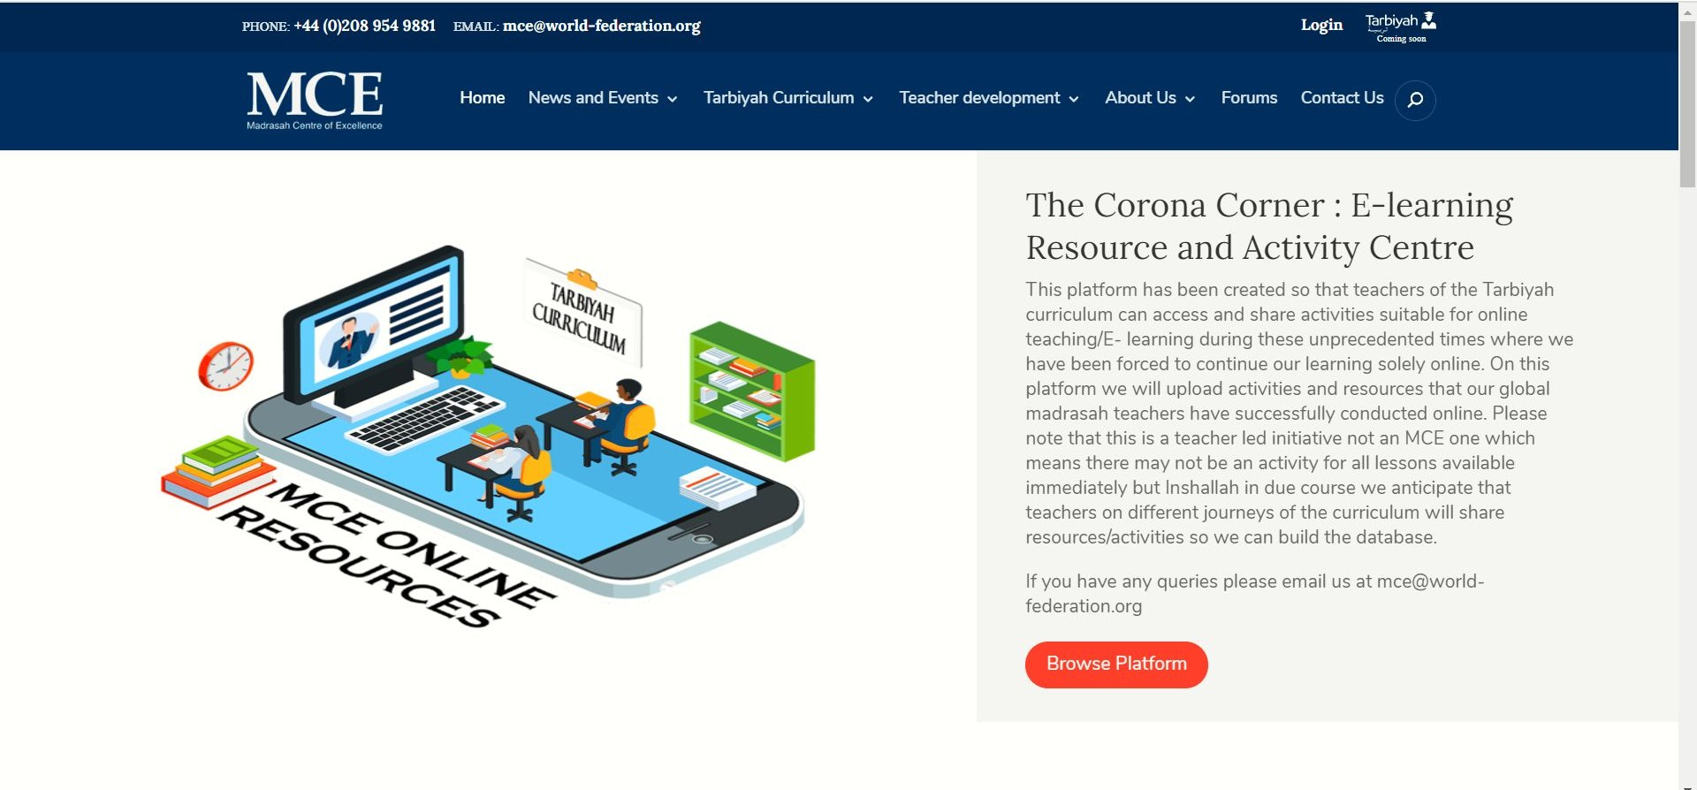
MCE Website
http://madrasahonline.org/
17

Slide 20

Quran Curriculum
Level 1 - Foundations of Tarteel Book 1
Level 2 - Foundations of Tarteel Book 2
Level 3 - Foundations of Tarteel Book 3
Level 4 - Iqra Book 4
Level 5 - Iqra Books 5 + 6
Level 6 - Lessons in Tajweed + Quran Study Levels 7-9
Quran Curriculum is highly comprehensive as it includes:
How to read Arabic (covers basics to more extensive content including Tajweed)
Quran study section
Tafsir of Surahs
Duas
The Quran Curriculum is highly comprehensive as every textbook covers:

Slide 21


What is Google Classroom?
a way to get all of
your students in one place and allows you to easily assign work and for students to turn it in.

Slide 22




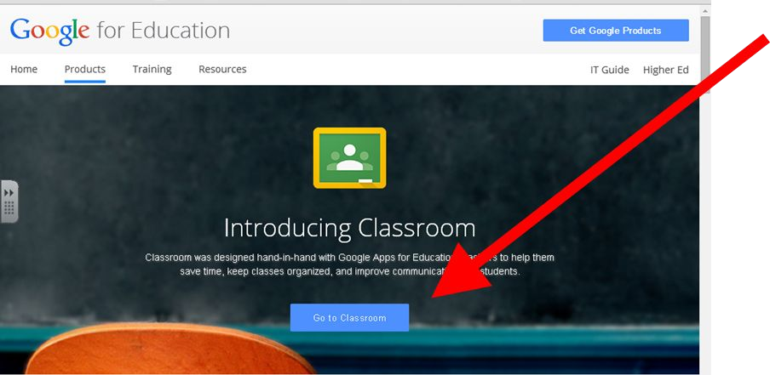



How do I access it?
Goto
https://classroom.google.com/
Click on
GO TO CLASSROOM

Slide 23
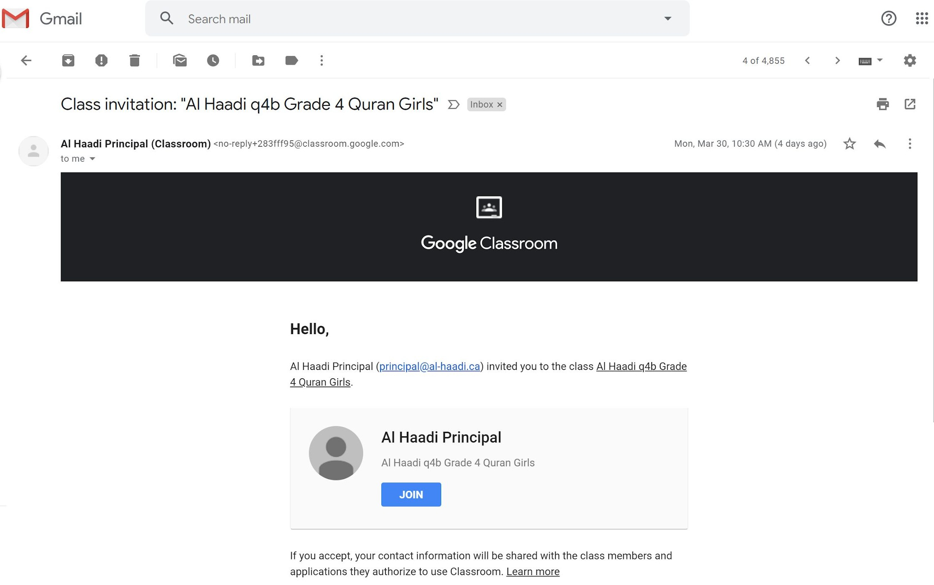
How to add yourself to a class
You will receive an email inviting you to a class
(Check your SPAM and JUNK folders)
Click on the JOIN button
It will automatically take you to the Google log in page

Slide 24
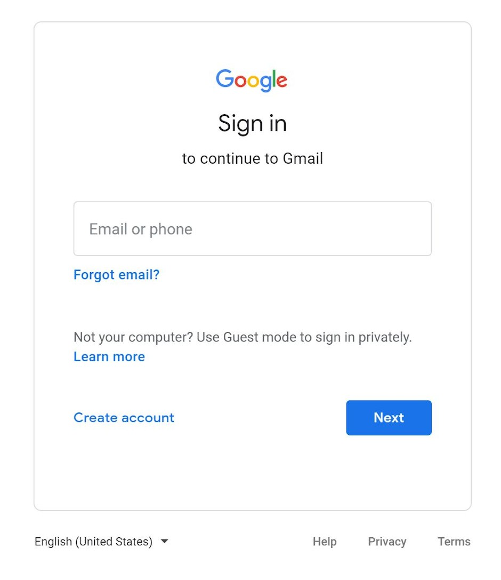
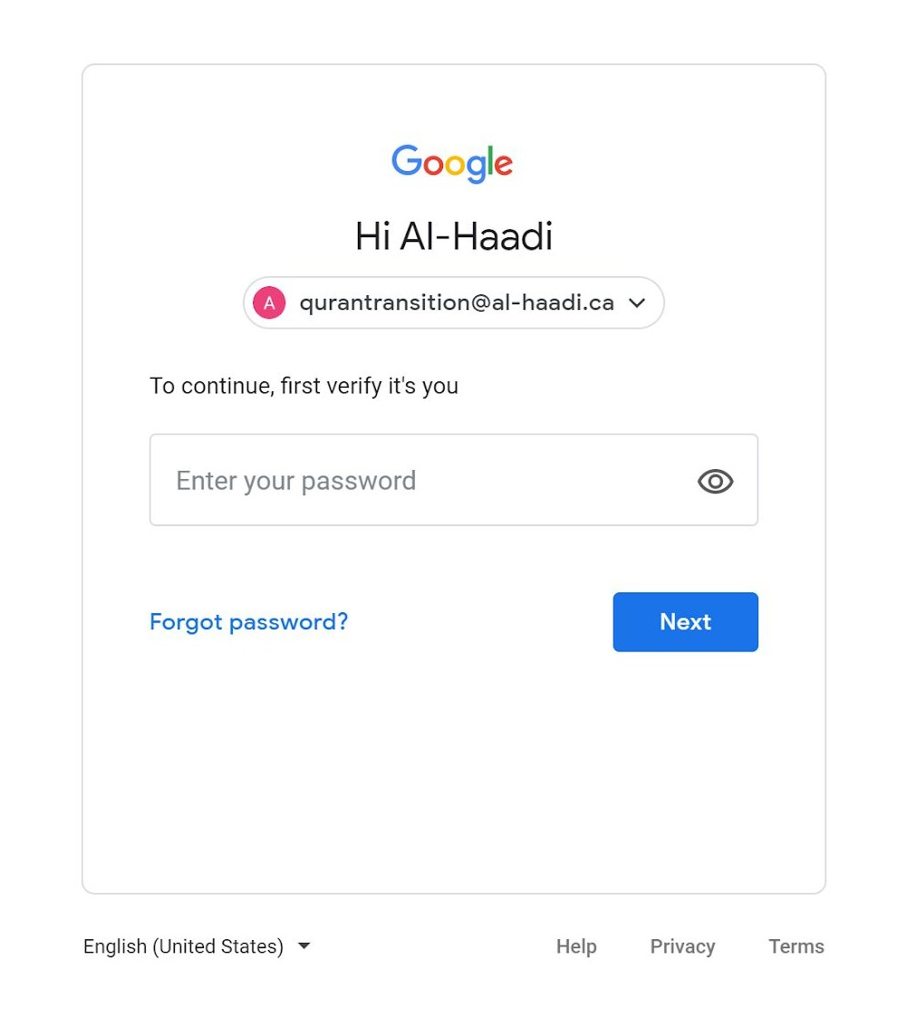


Put in a valid Gmail address and password to enter.
Google Classroom allows only Gmail addresses. (A Gmail account can be created for free at
https://accounts.google.com/signup/v2/webcreateaccount?ﬂowName=
GlifWebSignIn&ﬂowEntry=SignUp.)

Slide 25
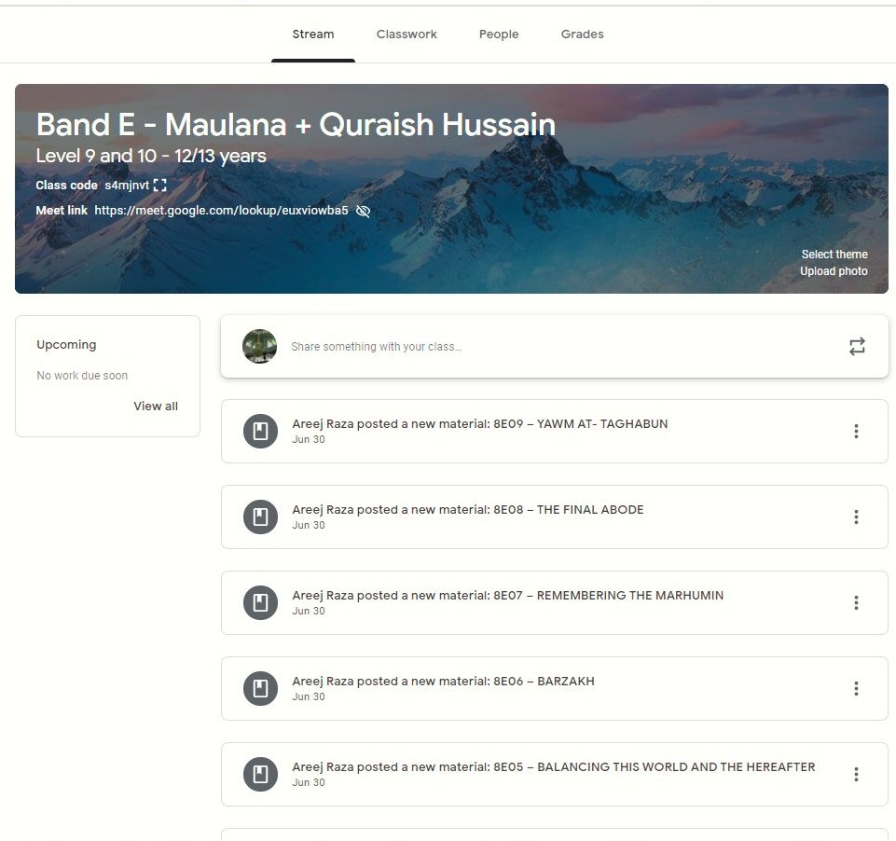
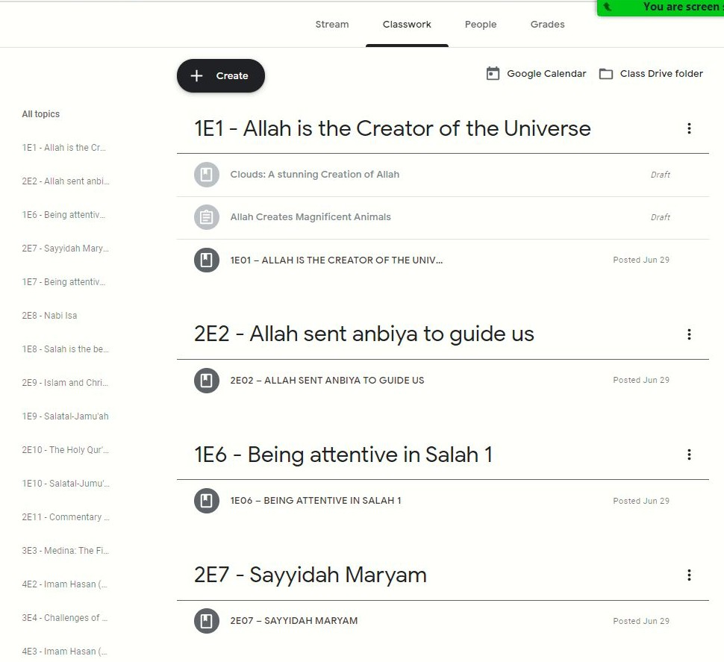
Sample Tarbiyah Class

Slide 26
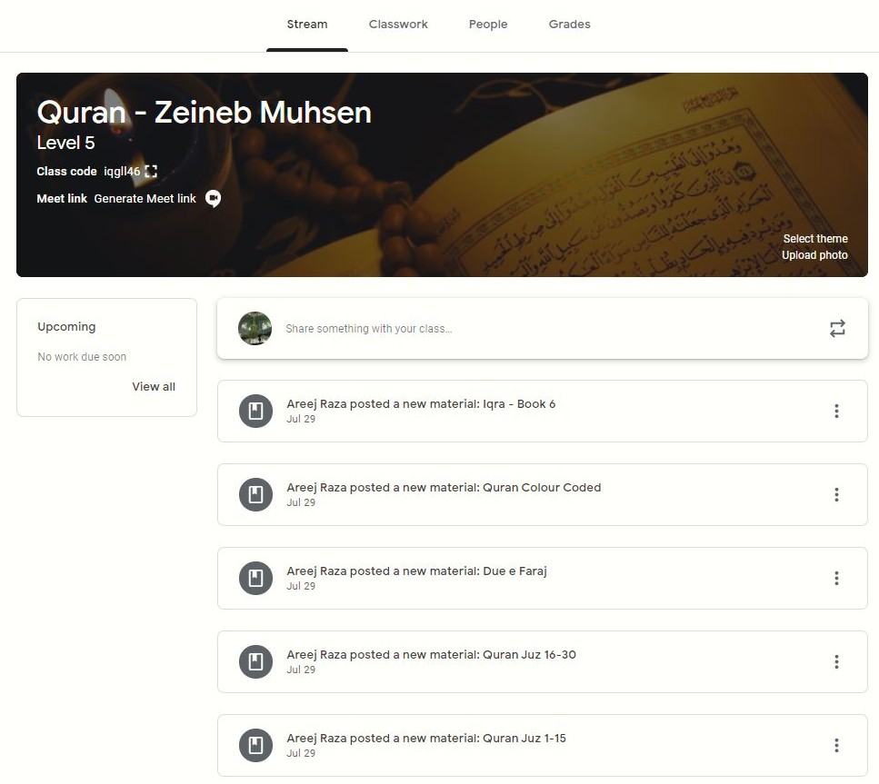
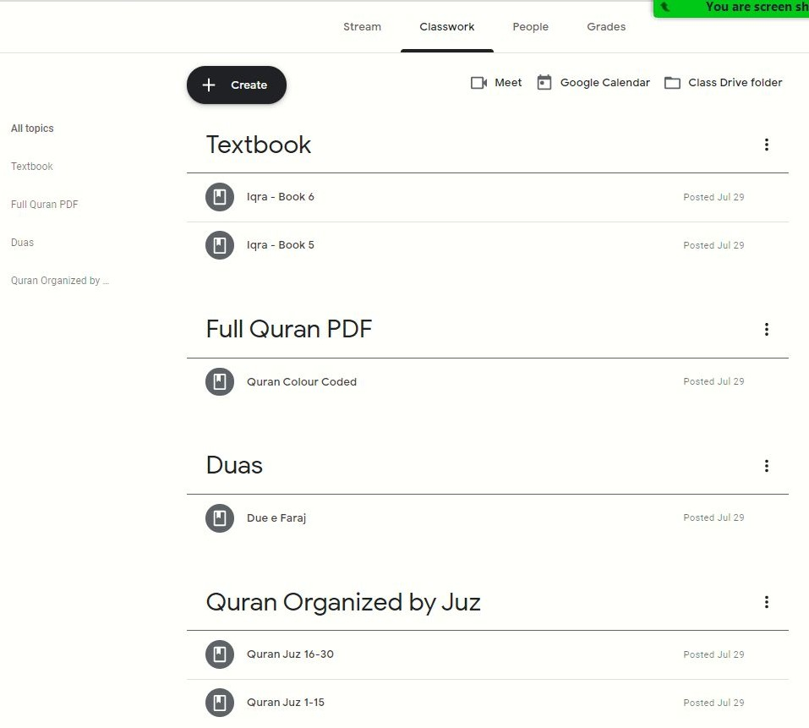
Sample Quran Class

Slide 27
How to get in touch with a teacher
All commenting features have been disabled in Google Classroom, to ensure that important messages don’t get lost.
To get in touch with the teacher, email them at their Al-Hujjat email addresses.
►

Slide 28

If you have any questions email admin@al-hujjat.ca

Slide 29
Dua Imam-e-Zamana by Syed Aamir Rizvi

Slide 30

Jazakallah
Questions?

